Slide 1
Chapter 7: Synchronization Examples

Slide 2
Outline
Explain the bounded-buffer synchronization problem
Explain the readers-writers synchronization problem
Explain and dining-philosophers synchronization problems
Describe the tools used by Linux and Windows to solve synchronization problems.
Illustrate how POSIX and Java can be used to solve process synchronization problems

Slide 3
Classical Problems of Synchronization
Classical problems used to test newly-proposed synchronization schemes
Bounded-Buffer Problem
Readers and Writers Problem
Dining-Philosophers Problem

Slide 4
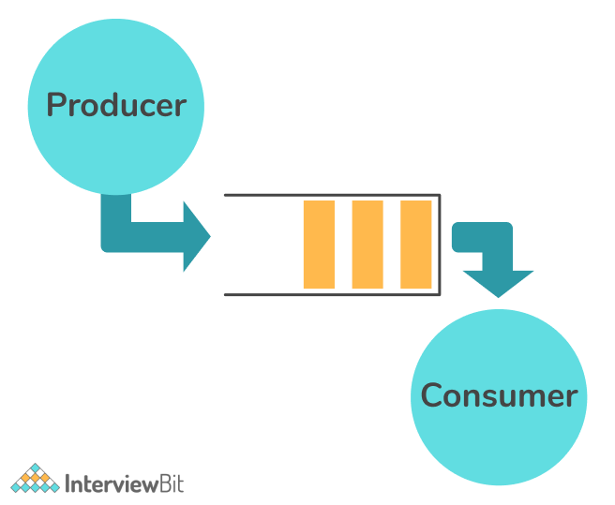
Bounded-Buffer Problem
https://www.interviewbit.com/blog/producer-consumer-problem/
Notes:
The producer tries to insert data into an empty slot of the buffer.
The consumer tries to remove data from a filled slot in the buffer.
The producer must not insert data when the buffer is full.
The consumer must not remove data when the buffer is empty.
The producer and consumer should not insert and remove data simultaneously.
----
For solving the producer-consumer problem, three semaphores are used:
m(mutex) : A binary semaphore which is used to acquire and release the lock.
empty(), a counting semaphore whose initial value is the number of slots in the buffer, since initially, all slots are empty.
full, a counting semaphore, whose initial value is 0.

Slide 5
Bounded-Buffer Problem
n buffers, each can hold one item
Semaphore mutex initialized to the value 1
Semaphore full initialized to the value 0
Semaphore empty initialized to the value n

Slide 6
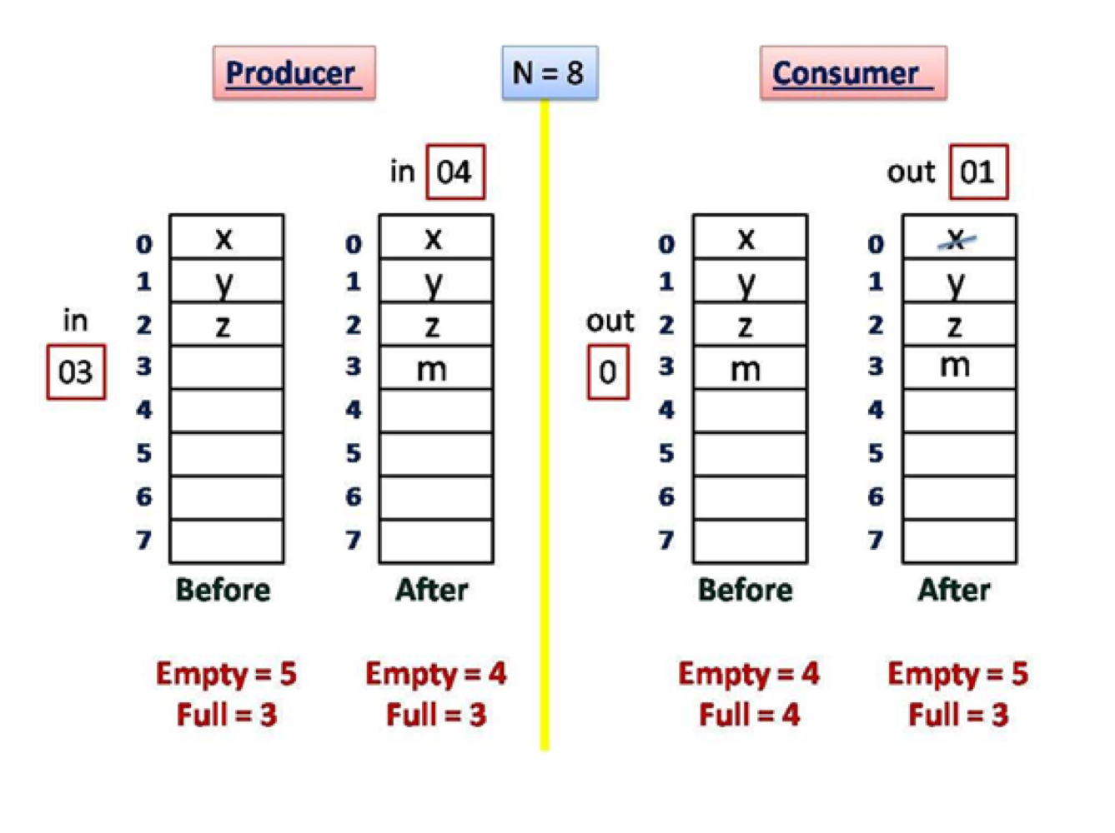
Bounded-Buffer Problem
https://mycareerwise.com/content/producer-consumer-problem-using-semaphores/content/exam/gate/computer-science
Notes:
-

Slide 7
Bounded Buffer Problem (Cont.)
The structure of the producer process
while (true) {
... /* produce an item in next_produced */
...
wait(empty);
wait(mutex);
... /* add next produced to the buffer */
...
signal(mutex);
signal(full);
}

Slide 8
Bounded Buffer Problem (Cont.)
The structure of the producer process
void producer()
{
--mutex;
--empty;
x++; // Item produced
printf("\nProducer produces item %d",x);
++mutex;
++full;
}

Slide 9
Bounded Buffer Problem (Cont.)
The structure of the consumer process
while (true) {
wait(full);
wait(mutex);
... /* remove an item from buffer to next_consumed */
...
signal(mutex);
signal(empty);
... /* consume the item in next consumed */
... }

Slide 10
Bounded Buffer Problem (Cont.)
int mutex = 1;
int full = 0;
int empty = 10;
int x = 0;

Slide 11
Bounded Buffer Problem (Cont.)
The structure of the consumer process
void consumer()
{
--full;
--mutex;
printf("\nConsumer consumes item %d", x);
x--;
++mutex; ++empty;
}

Slide 12
Readers-Writers Problem
A data set is shared among a number of concurrent processes
Readers – only read the data set; they do not perform any updates
Writers – can both read and write
Problem – allow multiple readers to read at the same time
Only one single writer can access the shared data at the same time
Several variations of how readers and writers are considered – all involve some form of priorities

Slide 13
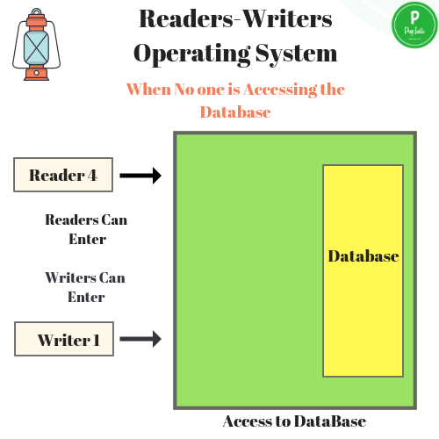
Readers-Writers Problem
https://prepinsta.com/operating-systems/readers-writers-problem/

Slide 14
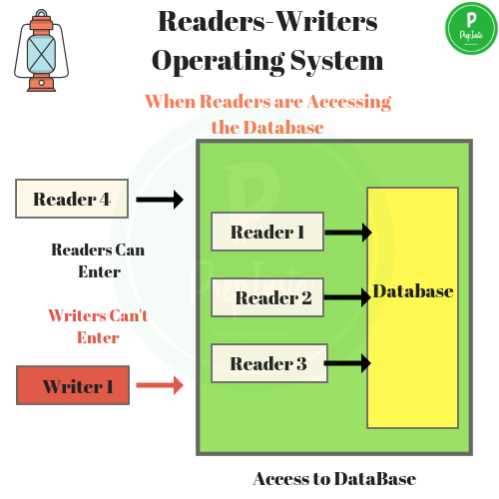
Readers-Writers Problem
https://prepinsta.com/operating-systems/readers-writers-problem/

Slide 15
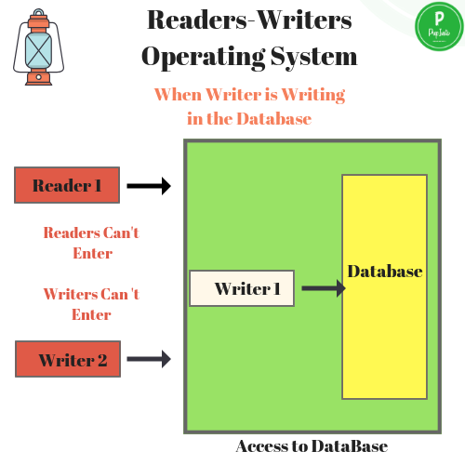
Readers-Writers Problem
https://prepinsta.com/operating-systems/readers-writers-problem/

Slide 16
Readers-Writers Problem (Cont.)
Shared Data
Data set
Semaphore rw_mutex initialized to 1
Semaphore mutex initialized to 1
Integer read_count initialized to 0
Notes:
Mutex – mutex (used for mutual exclusion, when readcount is changed)
initialised as 1
Semaphore – wrt (used by both readers and writers)
initialised as 1
readers_count – Counter of number of people reading the file
initialised as 0
wait() – performs as –, which basically decrements value of semaphore
signal() – performs as ++. which basically increments value of semaphore

Slide 17
Readers-Writers Problem (Cont.)
The structure of a writer process
while (true) { wait(rw_mutex);
... /* writing is performed */
...
signal(rw_mutex);
}

Slide 18
Readers-Writers Problem (Cont.)
The structure of a reader process
while (true){ wait(mutex); read_count++;
if (read_count == 1) /* first reader */
wait(rw_mutex);
signal(mutex);
... /* reading is performed */
...
wait(mutex); read_count--;
if (read_count == 0) /* last reader */
signal(rw_mutex);
signal(mutex);
}

Slide 19
Readers-Writers Problem Variations
The solution in previous slide can result in a situation where a writer process never writes. It is referred to as the “First reader-writer” problem.
The “Second reader-writer” problem is a variation the first reader-writer problem that state:
Once a writer is ready to write, no “newly arrived reader” is allowed to read.
Both the first and second may result in starvation. leading to even more variations
Problem is solved on some systems by kernel providing reader-writer locks

Slide 20

Dining-Philosophers Problem
N philosophers’ sit at a round table with a bowel of rice in the middle.
They spend their lives alternating thinking and eating.
They do not interact with their neighbors.

Slide 21
Dining-Philosophers Problem
N philosophers’ sit at a round table with a bowel of rice in the middle.
Occasionally try to pick up 2 chopsticks (one at a time) to eat from bowl
Need both to eat, then release both when done
In the case of 5 philosophers, the shared data
Bowl of rice (data set)
Semaphore chopstick [5] initialized to 1

Slide 22
Dining-Philosophers Problem Algorithm
Semaphore Solution
The structure of Philosopher i :
while (true){
wait (chopstick[i] );
wait (chopStick[ (i + 1) % 5] );
/* eat for awhile */
signal (chopstick[i] );
signal (chopstick[ (i + 1) % 5] );
/* think for awhile */
}
What is the problem with this algorithm?

Slide 23
Dining-Philosophers Problem Algorithm
sem_t room;
sem_t chopstick[5];
void *philosopher(void *);
void eat(int);
int main()
{
int i, a[5];
pthread_t tid[5];
sem_init(&room, 0, 4);
for (i = 0; i < 5; i++)
sem_init(&chopstick[i], 0, 1);
for (i = 0; i < 5; i++)
{
} a[i] = i;
pthread_create(&tid[i], NULL, philosopher, (void *)&a[i]);
for (i = 0; i < 5; i++)
pthread_join(tid[i], NULL);
}

Slide 24
Dining-Philosophers Problem Algorithm
void *philosopher(void *num)
{
int phil = *(int *)num;
sem_wait(&room);
printf("\nPhilosopher %d has entered room", phil);
sem_wait(&chopstick[phil]);
sem_wait(&chopstick[(phil + 1) % 5]);
eat(phil);
sleep(2);
printf("\nPhilosopher %d has finished eating", phil);
sem_post(&chopstick[(phil + 1) % 5]);
sem_post(&chopstick[phil]);
sem_post(&room);
}
void eat(int phil)
{
printf("\nPhilosopher %d is eating", phil);
}

Slide 25
Monitor Solution to Dining Philosophers
monitor DiningPhilosophers
{
enum {THINKING; HUNGRY, EATING} state [5];
condition self [5];
void pickup (int i) {
state[i] = HUNGRY;
test(i);
if (state[i] != EATING) self[i].wait;
}
void putdown (int i) {
state[i] = THINKING;
// test left and right neighbors
test((i + 4) % 5);
test((i + 1) % 5);
}

Slide 26
Solution to Dining Philosophers (Cont.)
void test (int i) {
if ((state[(i + 4) % 5] != EATING) &&
(state[i] == HUNGRY) &&
(state[(i + 1) % 5] != EATING) ) {
state[i] = EATING ;
self[i].signal () ;
}
}
initialization_code() {
for (int i = 0; i < 5; i++)
state[i] = THINKING;
}
}

Slide 27
Solution to Dining Philosophers (Cont.)
Each philosopher “i” invokes the operations pickup() and putdown() in the following sequence:
DiningPhilosophers.pickup(i);
/** EAT **/
DiningPhilosophers.putdown(i);
No deadlock, but starvation is possible

Slide 28
Kernel Synchronization - Windows
Uses interrupt masks to protect access to global resources on uniprocessor systems
Uses spinlocks on multiprocessor systems
Spinlocking-thread will never be preempted
Also provides dispatcher objects user-land which may act mutexes, semaphores, events, and timers
Events
An event acts much like a condition variable
Timers notify one or more thread when time expired
Dispatcher objects either signaled-state (object available) or non-signaled state (thread will block)

Slide 29
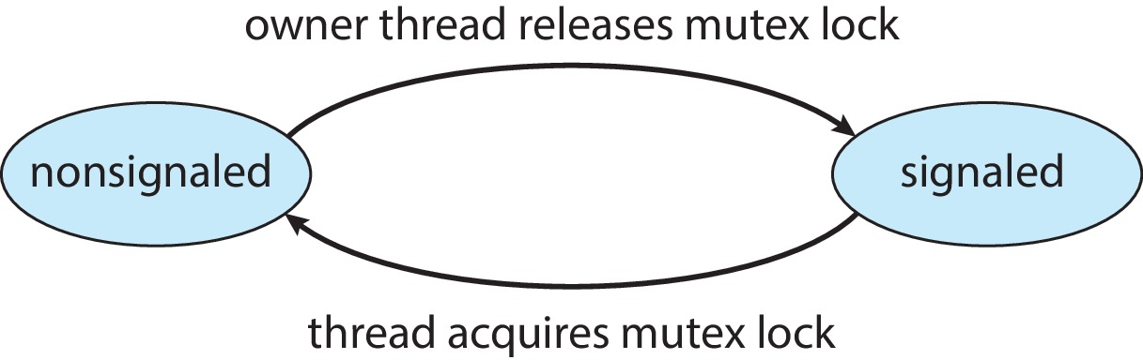
Kernel Synchronization - Windows
Mutex dispatcher object

Slide 30
Linux Synchronization
Linux:
Prior to kernel Version 2.6, disables interrupts to implement short critical sections
Version 2.6 and later, fully preemptive
Linux provides:
Semaphores
Atomic integers
Spinlocks
Reader-writer versions of both
On single-CPU system, spinlocks replaced by enabling and disabling kernel preemption

Slide 31
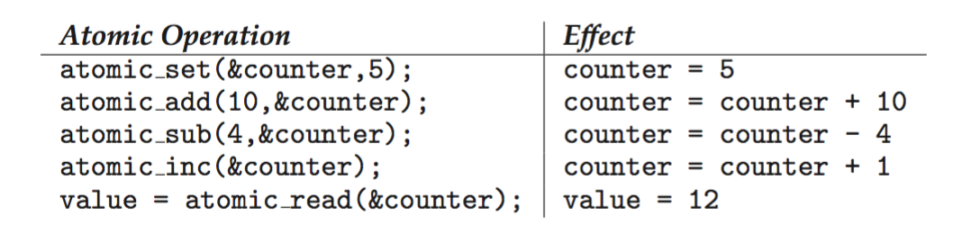
Linux Synchronization
Atomic variables atomic_t is the type for atomic integer
Consider the variables atomic_t counter; int value;
https://www.kernel.org/doc/html/v4.12/core-api/atomic_ops.html
Notes:
The atomic_t type should be defined as a signed integer and the atomic_long_t type as a signed long integer.
https://www.unix.com/man-page/linux/3C/atomic_add/

Slide 32
POSIX Synchronization
POSIX API provides
mutex locks
semaphores
condition variable
Widely used on UNIX, Linux, and macOS

Slide 33
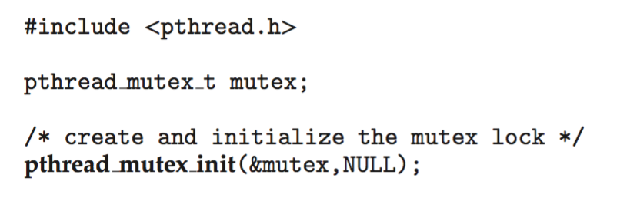
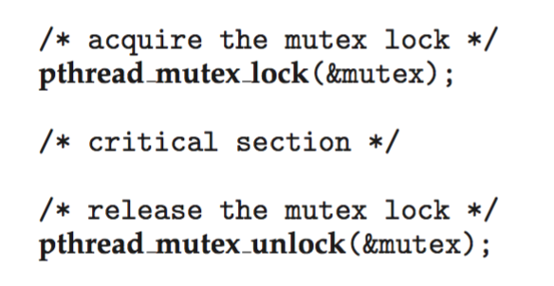
POSIX Mutex Locks
Creating and initializing the lock
Acquiring and releasing the lock

Slide 34
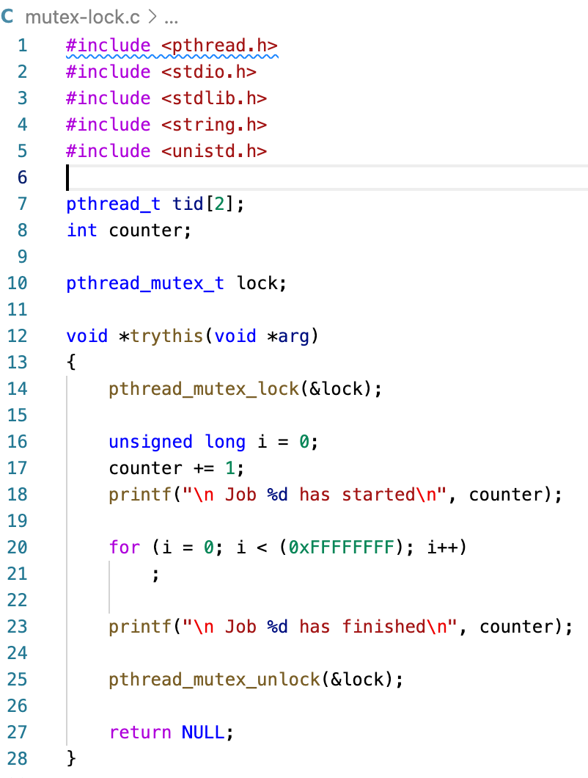
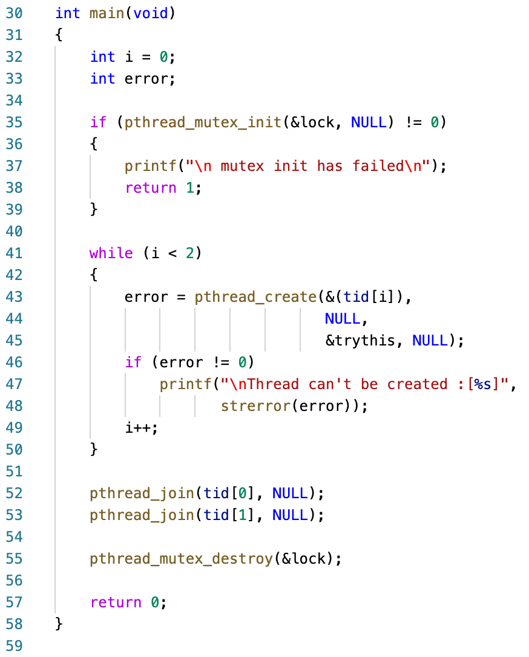
POSIX Mutex Locks
https://www.geeksforgeeks.org/mutex-lock-for-linux-thread-synchronization/

Slide 35
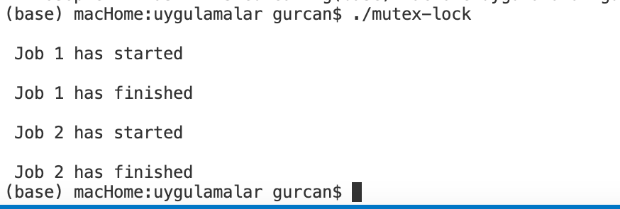
POSIX Mutex Locks

Slide 36
POSIX Semaphores
POSIX provides two versions
– named and unnamed.
Named semaphores can be used by unrelated processes, unnamed cannot.
Notes:
- https://eric-lo.gitbook.io/synchronization/semaphore-in-c

Slide 37
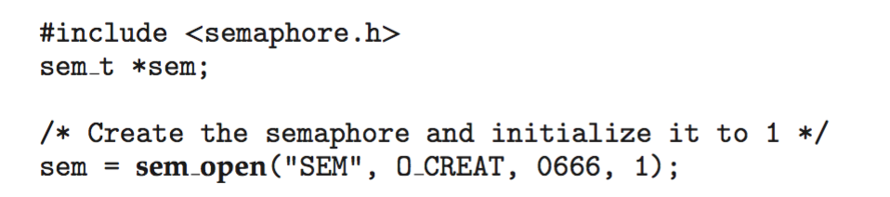
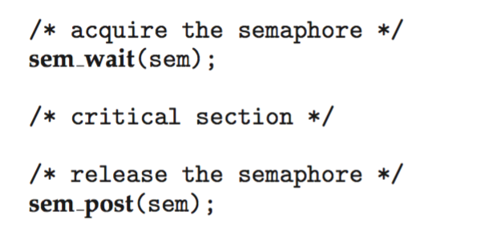
POSIX Named Semaphores
Creating an initializing the semaphore:
Another process can access the semaphore by referring to its name SEM.
Acquiring and releasing the semaphore:

Slide 38
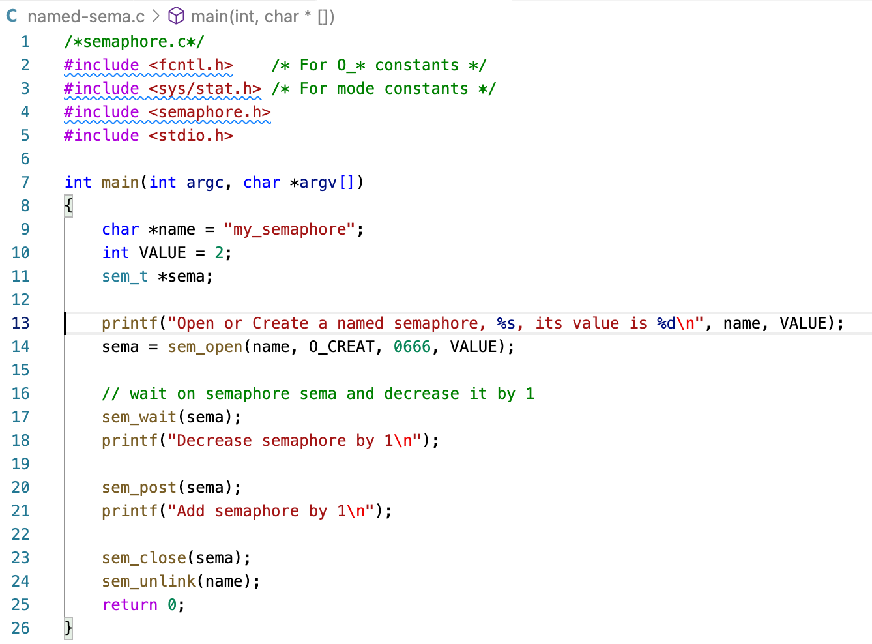
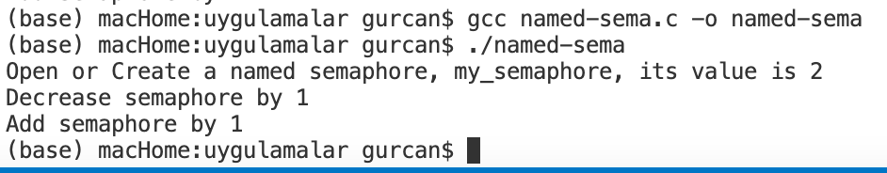
POSIX Named Semaphores
https://eric-lo.gitbook.io/synchronization/semaphore-in-c

Slide 39
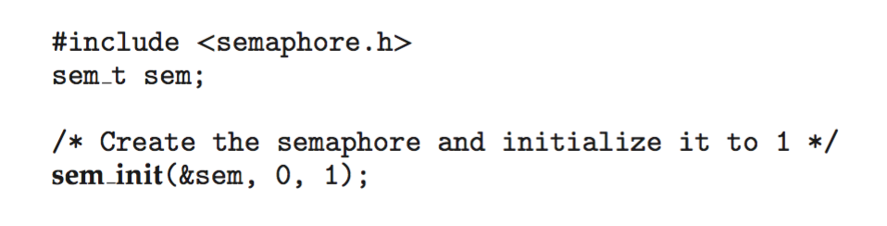
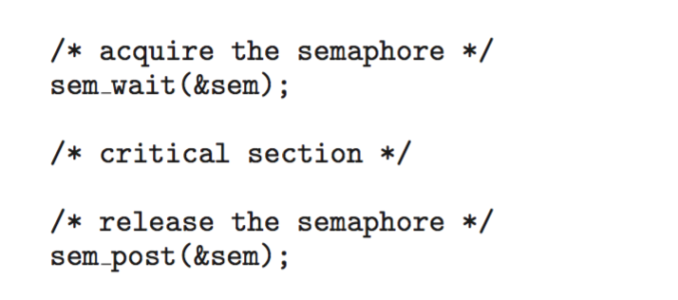
POSIX Unnamed Semaphores
Creating an initializing the semaphore:
Acquiring and releasing the semaphore:
Notes:
POSIX semaphores are available in two flavors: named and unnamed. They differ in how they are created and destroyed, but otherwise work the same. Unnamed semaphores exist in memory only and require that processes have access to the memory to be able to use the semaphores. This means they can be used only by threads in the same process or threads in different processes that have mapped the same memory extent into their address spaces. Named semaphores, in contrast, are accessed by name and can be used by threads in any processes that know their names.

Slide 40
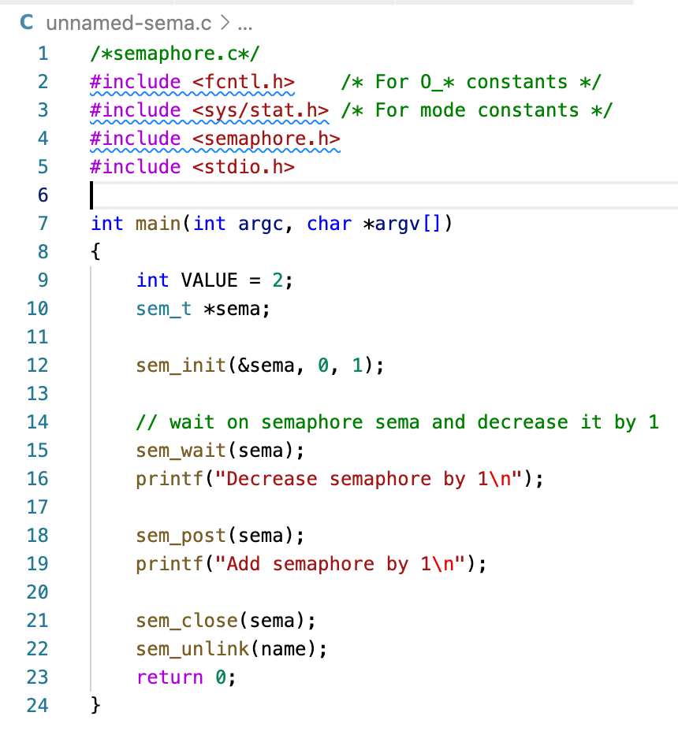
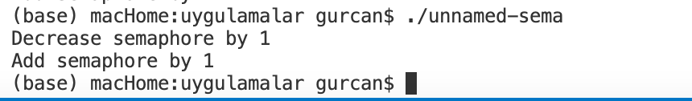
POSIX Unnamed Semaphores
Notes:
POSIX semaphores are available in two flavors: named and unnamed. They differ in how they are created and destroyed, but otherwise work the same. Unnamed semaphores exist in memory only and require that processes have access to the memory to be able to use the semaphores. This means they can be used only by threads in the same process or threads in different processes that have mapped the same memory extent into their address spaces. Named semaphores, in contrast, are accessed by name and can be used by threads in any processes that know their names.

Slide 41
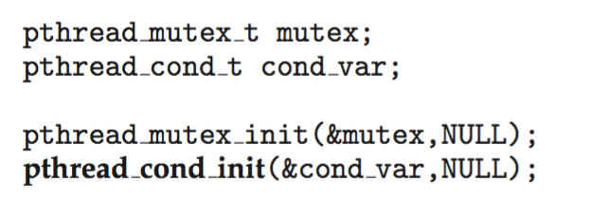
POSIX Condition Variables
Since POSIX is typically used in C/C++ and these languages do not provide a monitor, POSIX condition variables are associated with a POSIX mutex lock to provide mutual exclusion:
Creating and initializing the condition variable:

Slide 42
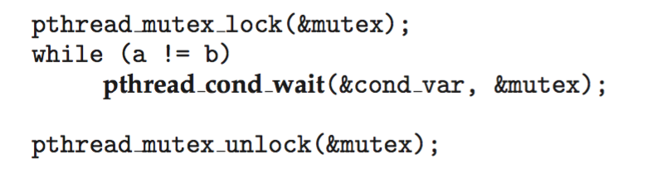
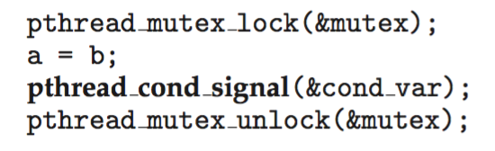
POSIX Condition Variables
Thread waiting for the condition a == b to become true:
Thread signaling another thread waiting on the condition variable:

Slide 43
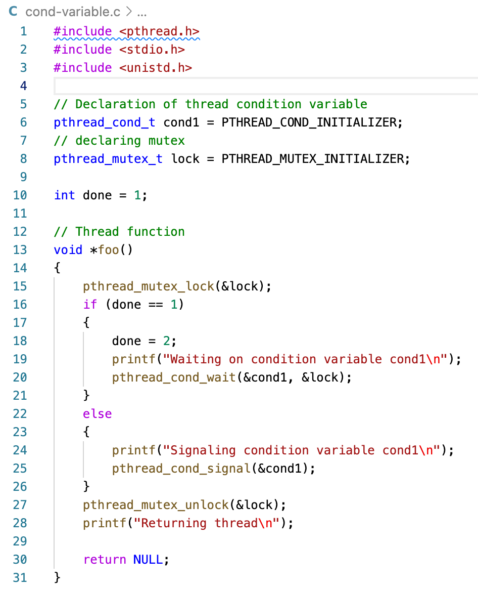
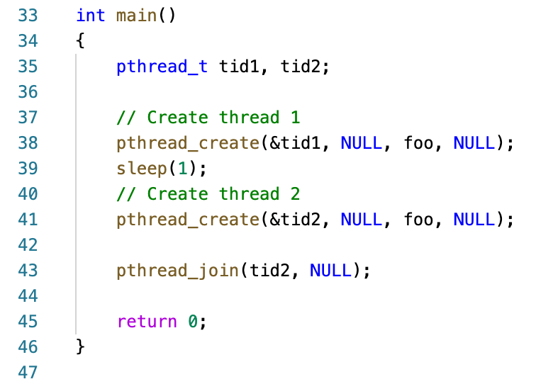
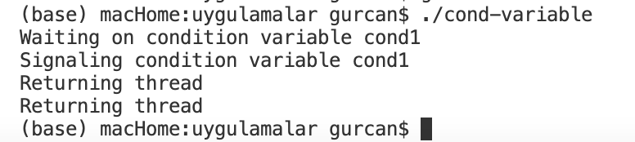
POSIX Condition Variables
https://www.geeksforgeeks.org/condition-wait-signal-multi-threading/

Slide 44
Java Synchronization
Java provides rich set of synchronization features:
Java monitors
Reentrant locks
Semaphores
Condition variables

Slide 45
Java Monitors
Every Java object has associated with it a single lock.
If a method is declared as synchronized, a calling thread must own the lock for the object.
If the lock is owned by another thread, the calling thread must wait for the lock until it is released.
Locks are released when the owning thread exits the synchronized method.

Slide 46
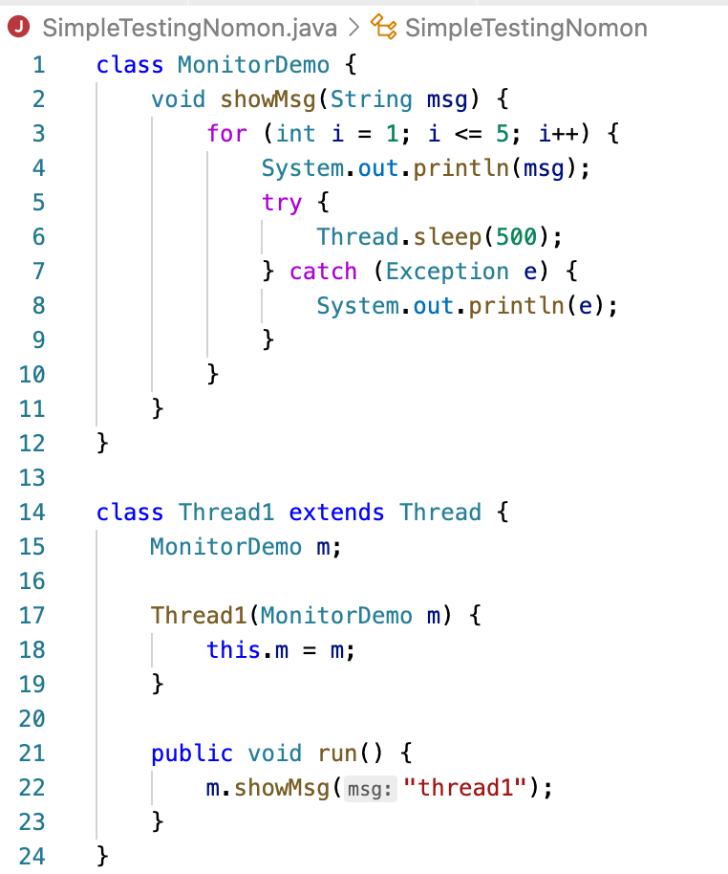
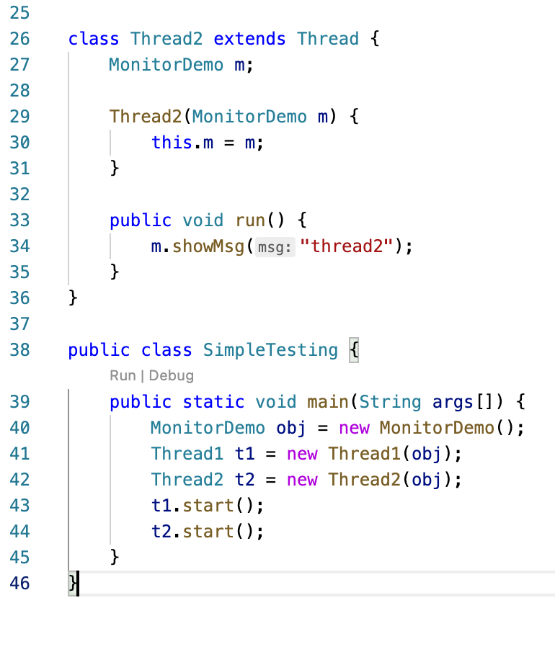
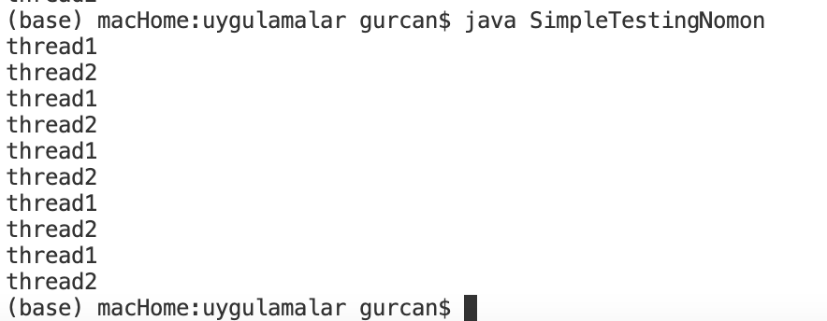
Java No Monitors
https://www.delftstack.com/howto/java/monitor-in-java/

Slide 47
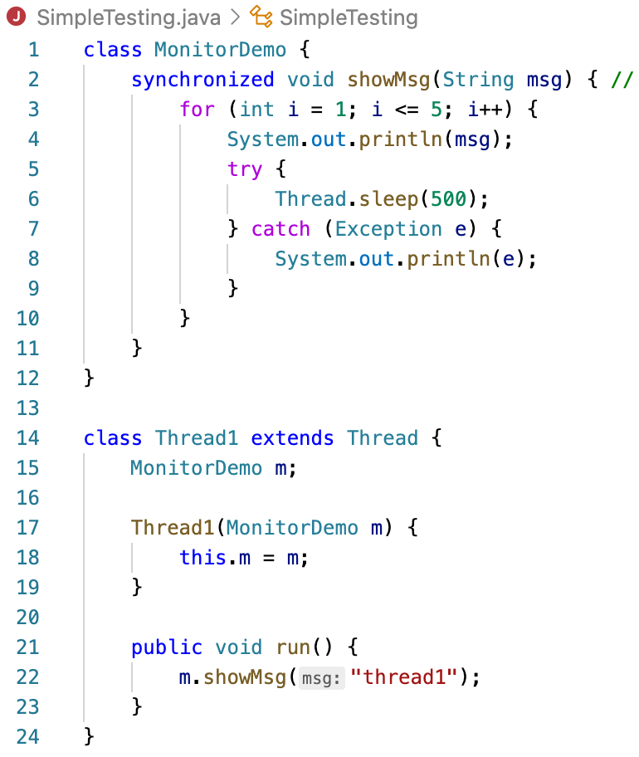
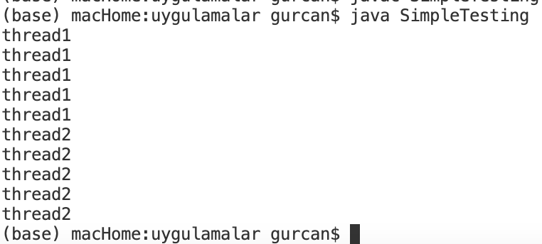
Java Monitors
https://www.delftstack.com/howto/java/monitor-in-java/

Slide 48
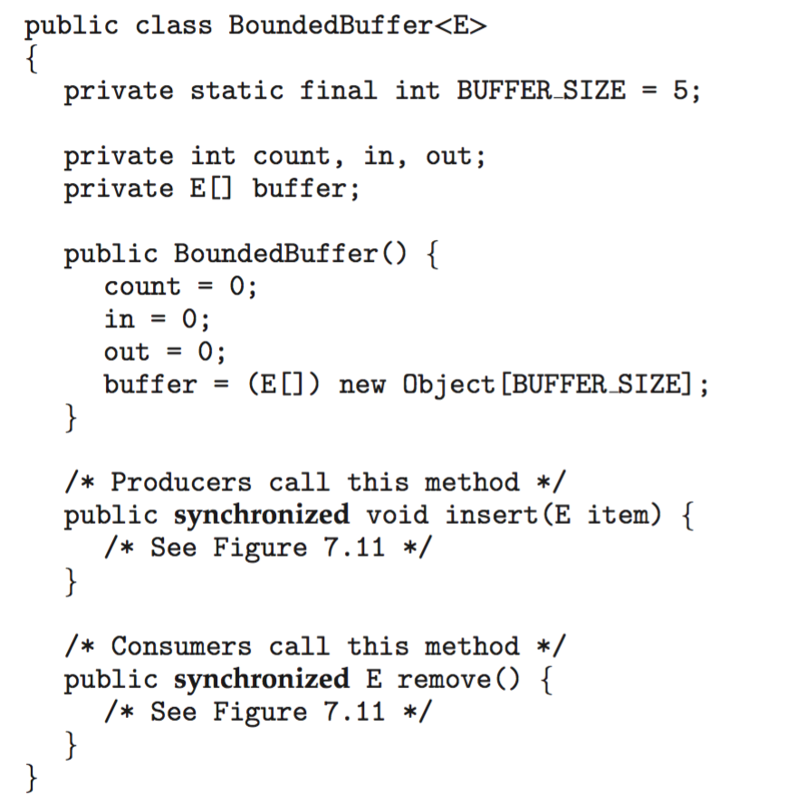
Bounded Buffer – Java Synchronization

Slide 49
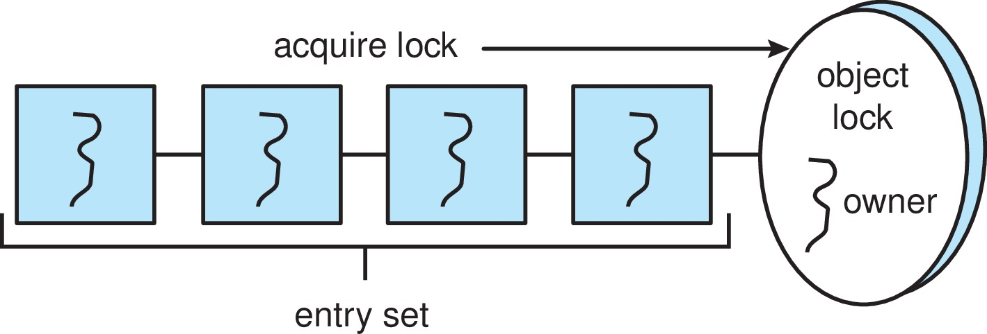
Java Synchronization
A thread that tries to acquire an unavailable lock is placed in the object’s entry set:

Slide 50
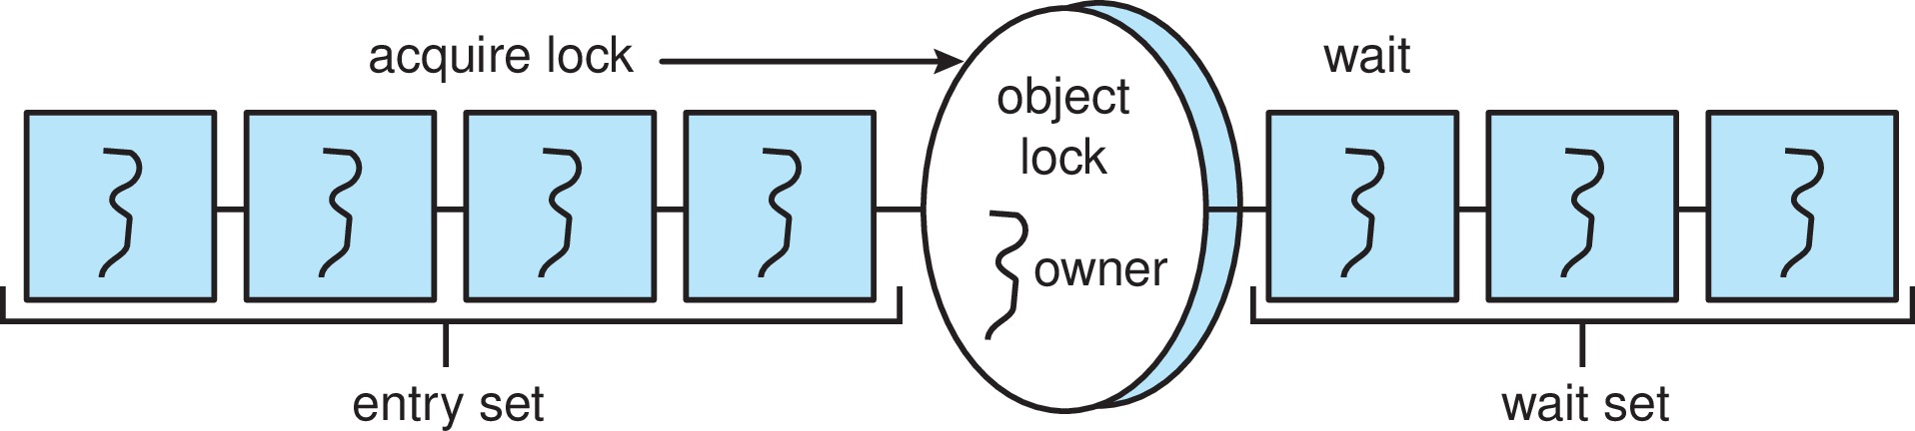
Java Synchronization
Similarly, each object also has a wait set.
When a thread calls wait():
It releases the lock for the object
The state of the thread is set to blocked
The thread is placed in the wait set for the object

Slide 51
Java Synchronization
A thread typically calls wait() when it is waiting for a condition to become true.
How does a thread get notified?
When a thread calls notify():
An arbitrary thread T is selected from the wait set
T is moved from the wait set to the entry set
Set the state of T from blocked to runnable.
T can now compete for the lock to check if the condition it was waiting for is now true.

Slide 52
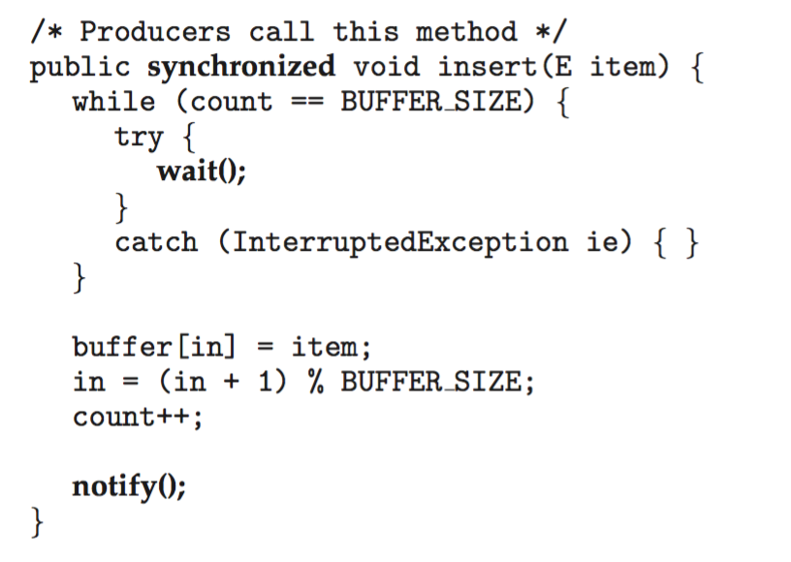
Bounded Buffer – Java Synchronization

Slide 53
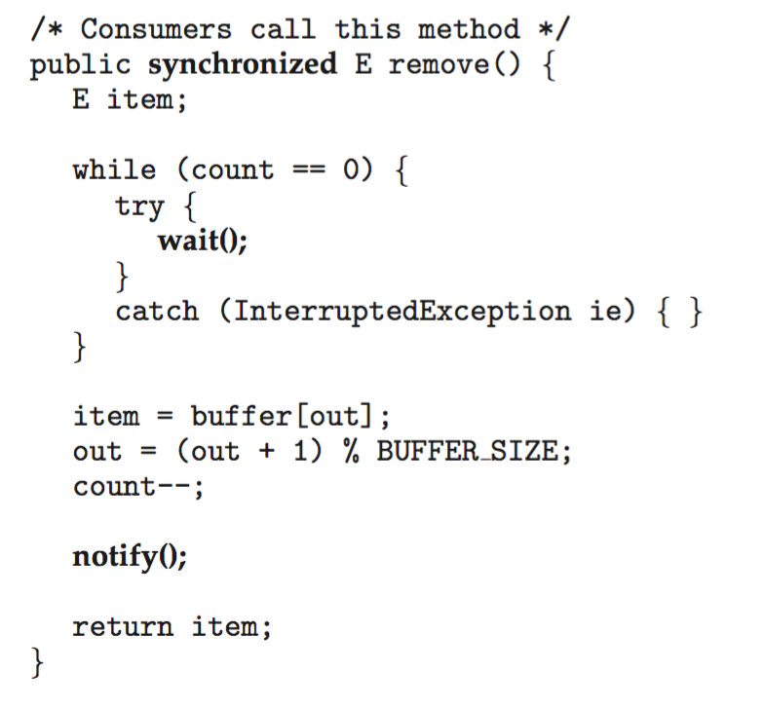
Bounded Buffer – Java Synchronization

Slide 54
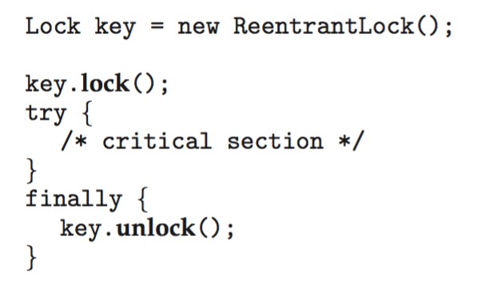
Java Reentrant Locks
Similar to mutex locks
The finally clause ensures the lock will be released in case an exception occurs in the try block.

Slide 55
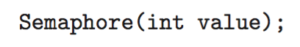
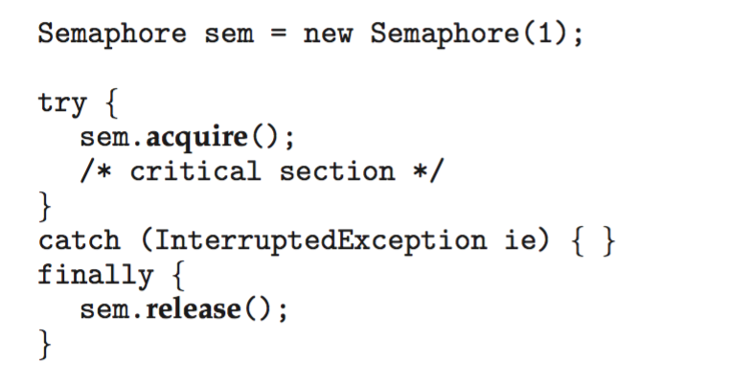
Java Semaphores
Constructor:
Usage:

Slide 56
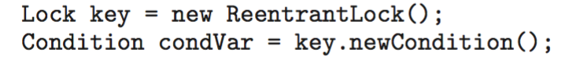
Java Condition Variables
Condition variables are associated with an ReentrantLock.
Creating a condition variable using newCondition() method of ReentrantLock:
A thread waits by calling the await() method, and signals by calling the signal() method.

Slide 57
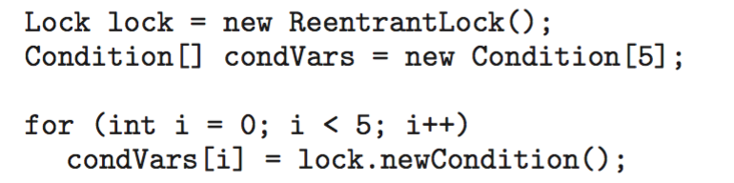
Java Condition Variables
Example:
Five threads numbered 0 .. 4
Shared variable turn indicating which thread’s turn it is.
Thread calls doWork() when it wishes to do some work. (But it may only do work if it is their turn.
If not their turn, wait
If their turn, do some work for awhile …...
When completed, notify the thread whose turn is next.
Necessary data structures:

Slide 58
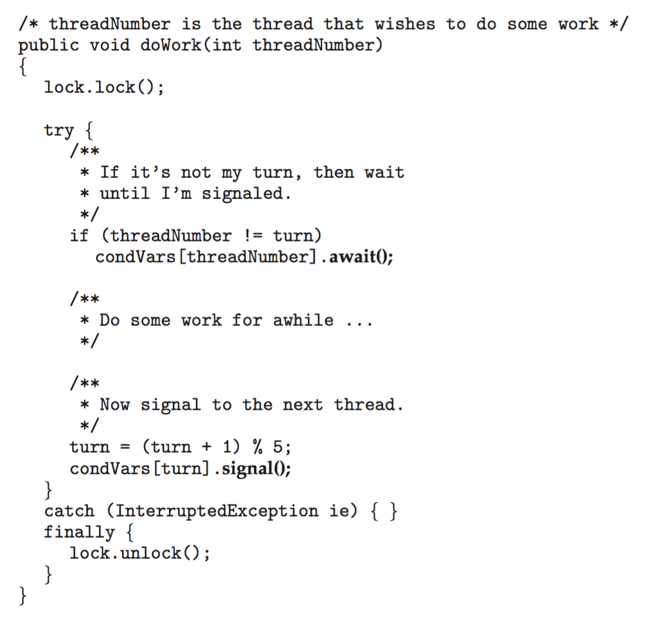
Java Condition Variables

Slide 59
Alternative Approaches
Transactional Memory
OpenMP
Functional Programming Languages

Slide 60
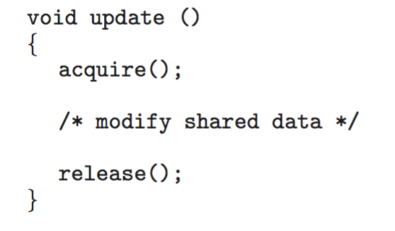
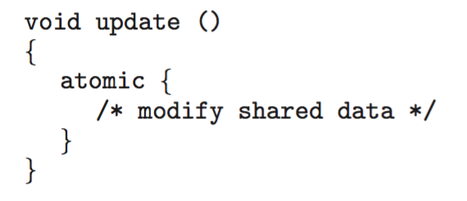
Transactional Memory
Consider a function update() that must be called atomically. One option is to use mutex locks:
A memory transaction is a sequence of read-write operations to memory that are performed atomically. A transaction can be completed by adding atomic{S} which ensure statements in S are executed atomically:

Slide 61
OpenMP
OpenMP is a set of compiler directives and API that support parallel progamming.
void update(int value)
{
#pragma omp critical
{
count += value
}
}
The code contained within the #pragma omp critical directive is treated as a critical section and performed atomically.

Slide 62
Functional Programming Languages
Functional programming languages offer a different paradigm than procedural languages in that they do not maintain state.
Variables are treated as immutable and cannot change state once they have been assigned a value.
There is increasing interest in functional languages such as Erlang and Scala for their approach in handling data races.

Slide 63
End of Chapter 7

